Slide 1


The Art of Design Patterns
2023
Prepared By:
Mohamed Samy
Notes:
Greetings , welcome to the Art of design patterns + Who am I?

Slide 2



What is a Design Pattern🤔?
Design patterns are Typical Solutions to commonly occurring problems in software design.
They are like pre-made Blueprints / Recipes that you can customize to solve a recurring design problem in your code.
You can’t just find a pattern and copy it into your program like functions or libraries. The pattern is not a specific piece of code, but a general concept
Notes:
Typical Sol Blueprint / Recipe Not a piece of code

Slide 3
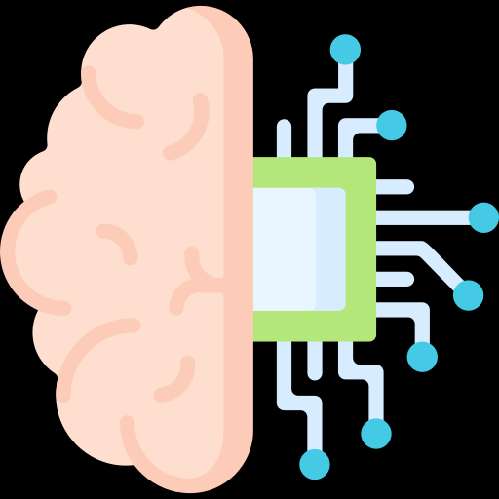
Design Patterns Vs Algorithms
Patterns are often confused with algorithms, both concepts describe typical solutions to some known problems.
Algorithm always defines a clear set of actions that can achieve some goal.
Pattern is a more high-level description of a solution. The code of the same pattern applied to two different programs may be different.

Slide 4
Why Should you learn Design Patterns?
Common interview questions.
Design patterns are a toolkit of tried and tested solutions to common problems in software design.
Teaches you how to solve problems using principles of object-oriented design.
Design patterns define a common language that you and your teammates can use to communicate more efficiently.
Notes:
You might manage to work as a programmer for many years without knowing about a single pattern. A lot of people do just that. Even in that case, though, you might be implementing some patterns without even knowing it, so why learn them ?

Slide 5

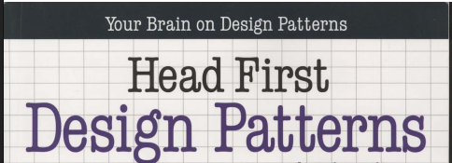
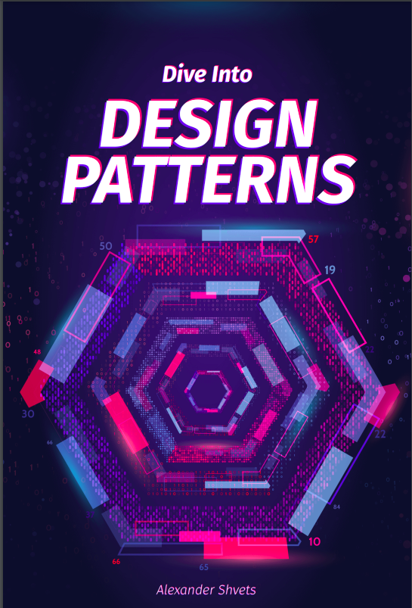
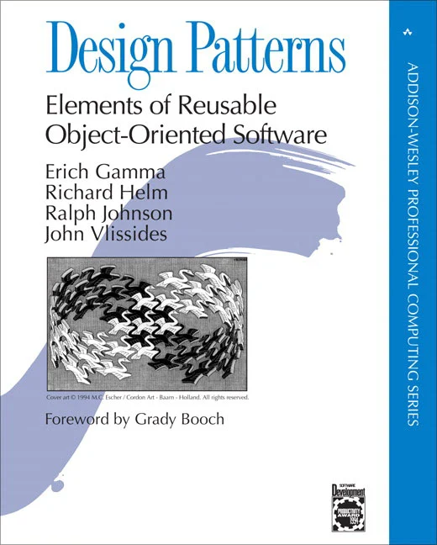
Resources
Recommended Books:
Dive into design patterns
Head first design patterns
Recommended Websites:
https://refactoring.guru

Slide 6
Three Main topics
Design Principles & SOLID
Creational, Structural and Behavioral Design Patterns
Refactoring & Clean Code
Notes:
Help you maintain large projects on long term easily update legacy code and add new features

Slide 7
Summer Training content
Session 1: OOP Recap, Design Principles & SOLID
Session 2: Creational Design Patterns
Session 3: Structural Design Patterns
Session 4: Behavioral Design Patterns
Session 5: Refactoring & Clean Code I
Session 6: Refactoring & Clean Code II
Session 7: Project evaluation

Slide 8
Logistics & Rules
Must attend at least 5 sessions, Session 1 & 7 are mandatory.
Incremental project
Support will be provided by S&T Committee via discord server
Teams 5-7 Members, Form will be released on discord
Code Examples are in Java

Slide 9
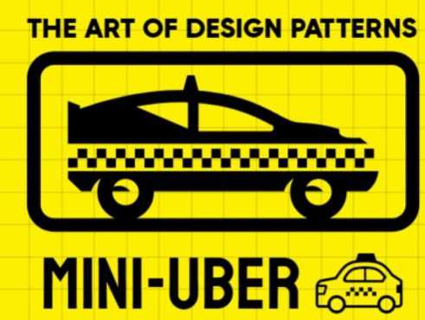


Project details
Incremental tasks released after each session
GUI is optional
Use only Java or C#
Evaluation “Session 7”:
Using correct design pattern for each task
Following SOLID principles
Clean code

Slide 10
Agenda
OOP recap
How does good software look like “Design Principles”?
SOLID Principles
UML
Evaluation

Slide 11
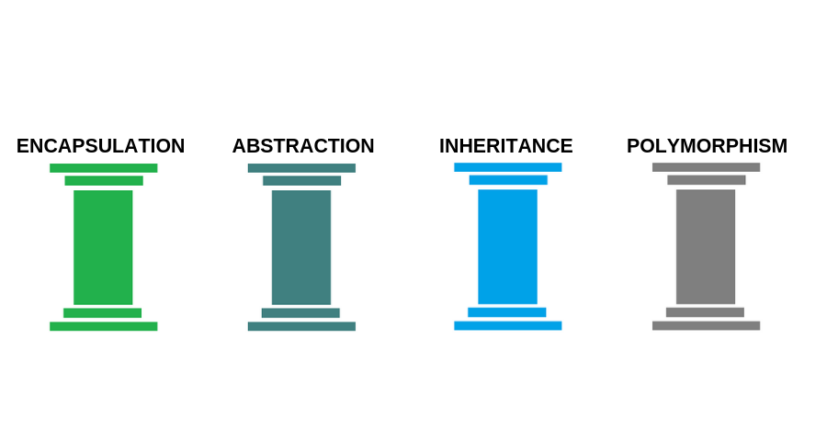
Object Oriented Programming
A recap on …
OOP
Object-oriented programming is a paradigm based on the concept of wrapping pieces of data, and behavior related to that
data, into special bundles called objects, which are constructed from a set of “blueprints”, defined by a programmer, called
classes

Slide 12
Polymorphism 🐛🦋
The ability of an object to “pretend” to be something else or expose different forms of implementation of existing functionality.
Facilitates having functionalities for specific use cases and modifying functionalities of existing implementations
Achieved by
Overloading : Same Function, same class, different parameters (Compile time Binding)
Overriding : Same Function, child class, same parameters (Runtime time Binding)
Notes:
We won’t go into details you already know OOP

Slide 13
Encapsulation 🔒
The ability of an object to:
hide its: State -> (Field Values) and Behavior -> (Functions & Constructors) From other objects.
Expose only the required interfaces -> (Like setters and getters)
Achieved using -> Access modifiers (Public , Private) and Class Scopes

Slide 14
Code Example🚗
public class Car {
private String name;
private String color;
private int speed;
public Car(String name, String color, int speed) {
this.name = name;
this.color = color;
this.speed = speed;
}
public String getColor() {
return color;
}
public void setColor(String color) {
if (color.equals("red") || color.equals("blue") || color.equals("green")) {
this.color = color;
} else {
System.out.println("Invalid color");
}
}
@Override
public String toString() {
return "Car [color=" + color + ", name=" + name + ", speed=" + speed + "]";
}

Slide 15
public class Car {
private String name;
private String color;
private int speed;
public Car(String name, String color, int speed) {
this.name = name;
this.color = color;
this.speed = speed;
}
public String getColor() {
return color;
}
public void setColor(String color) {
if (color.equals("red") || color.equals("blue") || color.equals("green")) {
this.color = color;
} else {
System.out.println("Invalid color");
}
}
@Override
public String toString() {
return "Car [color=" + color + ", name=" + name + ", speed=" + speed + "]";
}
All Data related to the Object are groped together in the class scope

Slide 16
public class Car {
private String name;
private String color;
private int speed;
public Car(String name, String color, int speed) {
this.name = name;
this.color = color;
this.speed = speed;
}
public String getColor() {
return color;
}
public void setColor(String color) {
if (color.equals("red") || color.equals("blue") || color.equals("green")) {
this.color = color;
} else {
System.out.println("Invalid color");
}
}
@Override
public String toString() {
return "Car [color=" + color + ", name=" + name + ", speed=" + speed + "]";
}
All needed attributes are defined and usually private
Constructor is public to allow instantiating new objects
Interfaces that we need to interact with object are made public
Encapsulation allowed us to enforce constraints on the possible values

Slide 17
Encapsulate What Varies
“Identify the aspects of your application that vary and separate them from what stays the same”
Notes:
DESIGN PRINCIPLE #1: main goal of this principle is to minimize the effect caused by changes. isolate the parts of the program that vary in independent modules, protecting the rest of the code from adverse effects. As a result, you spend less time getting the program back into working shape, implementing and testing the changes. The less time you spend making changes, the more time you have for implementing features.

Slide 18

Abstraction
Abstraction is a model of a real-world object or phenomenon limited to a specific context, which represents all details relevant to this context with high accuracy and omits all the rest.
Hide implementation details from classes that depend on it
Used to enforce some design constraints on object
EX: Every Animal can Breathe()
Achieved using -> Interfaces and Abstract Classes
Note: Abstract -> No implementation Vs. Concrete -> Have implementation

Slide 19


Let’s play a game!
Under this box there is an animal, what can you know about it without revealing what is under the box?
Notes:
It can breathe, move, eat, heal. We know that because they are “Traits” every animal should have, though there is know distinct creature called “Animal”, it’s just an “Abstract” description

Slide 20
Let’s play a game!
What if I told you it can swim?
Notes:
It’s either a fish @overrides breathe() or animal, but both of them can swim()

Slide 21
Let’s play a game!
What if I told you it’s a bird?
Notes:
An “Abstract” description right? ,It will definitely have wings, but does it fly?, it will have a peck, eat insects or fish, No distinct Animal called Bird

Slide 22
Did you know what it was?
A Penguin 🐧!!
Notes:
It will definitely have wings, but does it fly?, it will have a peck, eat insects or fish, No distinct Animal called Bird

Slide 23
Did you know what it was?
A Penguin 🐧!!
Notes:
It will definitely have wings, but does it fly?, it will have a peck, eat insects or fish, No distinct Animal called Bird

Slide 24
Inheritance 👨‍👩‍👧‍👦
The ability to build new classes based on existing ones.
Facilitates Code reuse by extending the current classes and adding or modifying the existing functionality to a new one.
If a superclass implements an interface or abstract class, all its subclasses must either implement it or be abstract.
Most languages allow to inherit from only one superclass and multiple interfaces.
Achieved by -> Extending existing classes , Implementing Interfaces

Slide 25


Code Example on abstraction and inheritance
Plug
Outlet

Slide 26
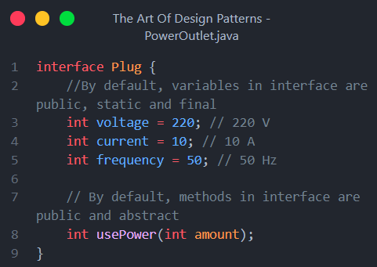
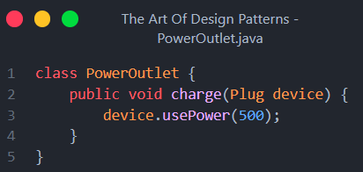
Example
- This means that objects of any class that implements the interface Plug can be passed to this function.
- The function charge() knows that the device object will always have the usePower() function implemented regardless of the concrete implementation
Notes:
Using interface ensured that object passed to function must have the function usePower()
Any class & Implements -> generalization / inheritance, + Abstraction for using interface

Slide 27
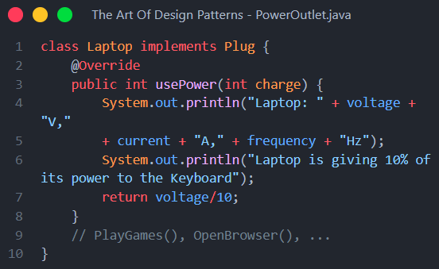
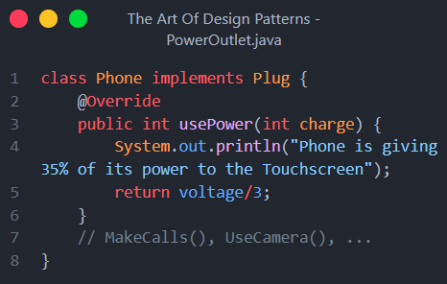


Example
The Outlet does not care about what else can the object do other than usePower()
charge()
Notes:
You don’t have to know how electricity comes from the plug, you just need to know how to use it, All manufacturers have to implement same standards, which removes need for making specific plugs for laptops, phone etc… Abstraction allow outlet to only use the Plug part of device

Slide 28
Example
charge()
Laptop
Phone
Outlet
By Inheritance, we can consider that both Laptop & Phone IS-A Plug,
Therefore it can usePower()
Notes:
You don’t have to know how electricity comes from the plug, you just need to know how to use it, All manufacturers have to implement same standards, which removes need for making specific plugs for laptops, phone etc… Abstraction allow outlet to only use the Plug part of device

Slide 29
Example
charge()
Plug
Plug
Outlet
“Laptop implementation of usePower()”
“Phone implementation of usePower()”
By Abstraction, we don’t have to know anything about the “device” as long as it implements the required functionality, we also don’t care How it was implemented
Notes:
You don’t have to know how electricity comes from the plug, you just need to know how to use it, All manufacturers have to implement same standards, which removes need for making specific plugs for laptops, phone etc… Abstraction allow outlet to only use the Plug part of device

Slide 30
abstract class Vehicle{
String name;
String color;
int speed;
abstract int calculateSpeed();
}
interface Vehicle{
String name;
String color;
int speed;
int calculateSpeed();
}
Abstract classes:
Have both abstract and concrete methods
Need to use abstract keyword before functions
No multiple inheritance
Use “Default (Package-Local)” as a default access modifier
Interfaces :
Have only abstract methods
No need to use abstract keyword before functions
Multiple inheritance
Use “Public static final” as a default access modifiers

Slide 31

Design Principles

Slide 32

BREAK

Slide 33

A Solid understanding of ?
A set of 5 software design principles intended to make software designs more understandable, flexible and maintainable
The SOLID principles were developed by Robert C. Martin in a 2000 essay, “Design Principles and Design Patterns”

Slide 34

A Solid understanding of ?
S
ingle Responsibility Principle
“A class should do one thing and therefore it should have only a single reason to change.”
And therefore, you need to:
Make a class responsible for only one thing.
Put separate logic in separate class

Slide 35
class Book {
String name;
String authorName;
int year;
int price;
public Book(…) {…}
}
public class Invoice {
private Book book; ⬅
private int quantity;
private double discountRate;
private double taxRate;
private double total;
public Invoice(…) {…}
public double calculateTotal() {…}
public void printInvoice() {…}
public void saveToFile(…) {…} }
A Model class used to hold the book data Usually looks like the structure of data in the database and mostly contains fields
A Business logic class used to Calculate price, print receipts … and
mostly Contains functions

Slide 36
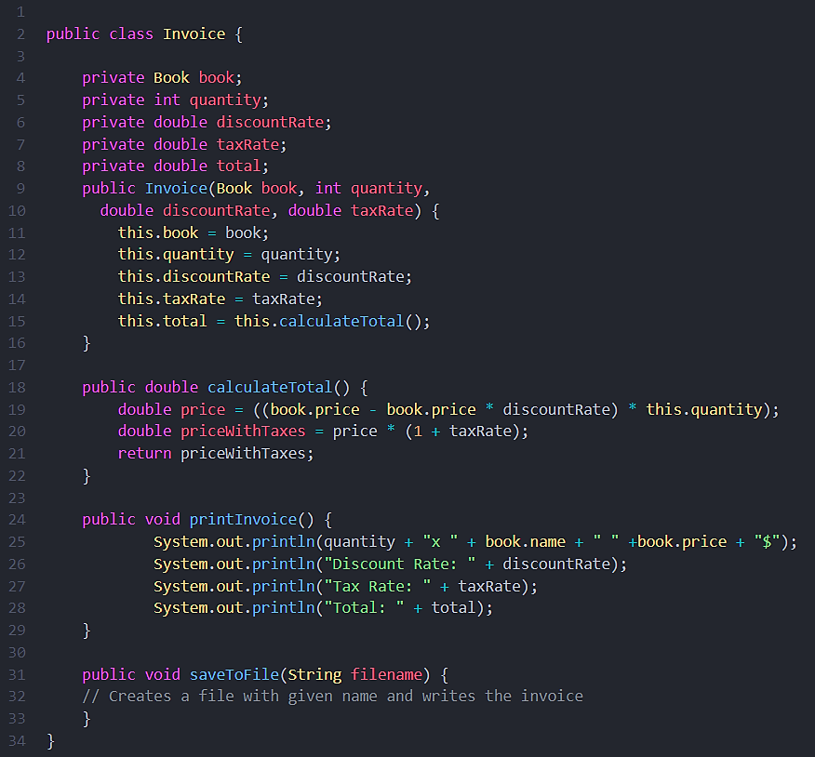
Challenge:
Find mistakes / Anti-patterns that violate SRP

Slide 37
Class model data and constructor ✅
Class business logic (main purpose) ✅
Printing logic ❌
Persistence logic ❌

Slide 38
if we wanted to change the printing format, we would need to change the class. Therefore, we should not have printing logic mixed with business logic in the same class.

Slide 39
It is also a very common mistake to mix persistence logic with business logic.

Slide 40
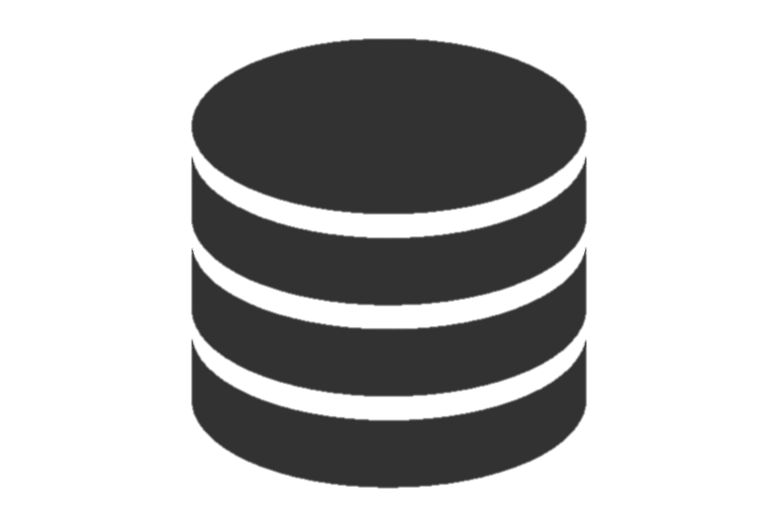

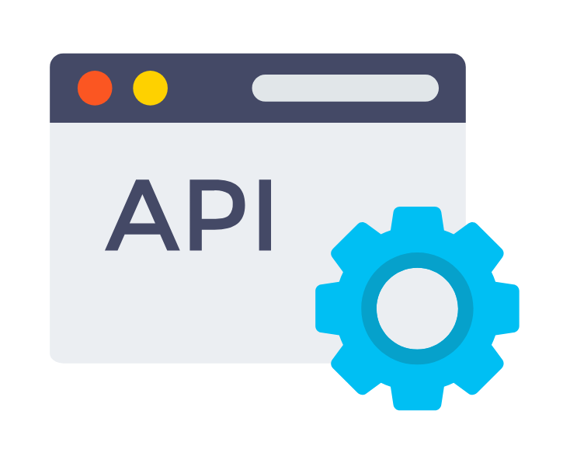
It is also an extremely common mistake to mix persistence logic with business logic.
Persistence is to save data to a permanent datastore
Persistence ?
Examples:
Writing to local file (filestreams) common with desktop apps
Writing to a local database (SQLite , RoomDB, SQLFlite) common with mobile apps and small desktop apps
Making an API call (PUT, UPDATE, DELETE) common with web apps -usually called Controller class-

Slide 41
How to fix that?
Make every class responsible for a single part of the functionality provided by the software, and make that responsibility entirely encapsulated by the class.
Make each function do only one thing

Slide 42

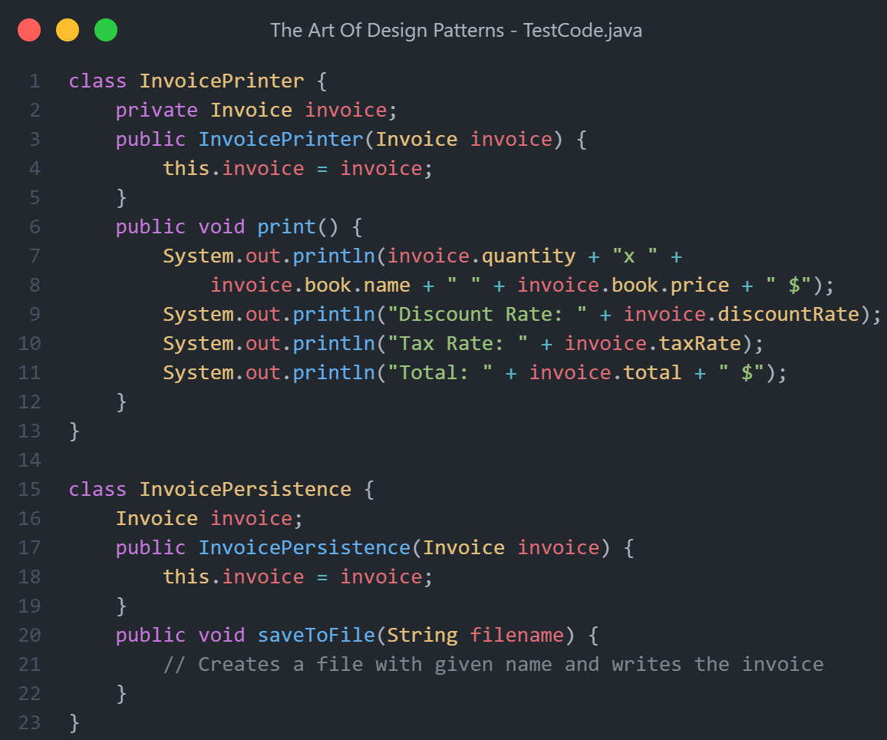
Fixed code

Slide 43
Open-Closed Principle (OCP)
“Classes should be open for extension and closed to modification.”

Slide 44
Why OCP?
We should be able to add new functionality without touching the existing code for the class.
Modifying existing code could potentially break existing functionality
Avoid touching the tested and reliable production code as long as possible.
Changes in a parent class may break classes derived (inherited) from it.

Slide 45
Open Class vs Closed Class
Class is open if :
You can extend it, produce a subclass (Not final) and do whatever you want with it—add new methods or fields, override base behavior
Class is closed if:
Class is closed (complete) if it’s 100% ready to be used by other classes—its interface is clearly defined and won’t be changed in the future.

Slide 46
How does it work ?
Instead of changing the code of the class directly, you can:
Create a subclass and override parts of the original class that you want to behave differently. You’ll achieve your goal but also won’t break any existing clients of the original class.
Note: This principle isn’t meant to be applied for all changes to a class. If you know that there’s a bug in the class, just go on and fix it

Slide 47
Liskov Substitution Principle
“When extending a class, remember that you should be able to pass objects of the subclass in place of objects of the parent class without breaking the client code.”
This means that the subclass should remain compatible with the behavior of the superclass.
When overriding a method, extend the base behavior rather than replacing it with something else entirely.
Notes:
In general, the behavior of child class should be similar to or subset from the behavior of parent class

Slide 48
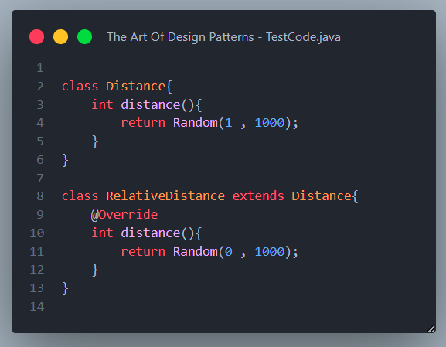
Passing a child in the place of its parent should never break the code or logic

Slide 49
Here, RelativeDistance.distance() can occasionally return 0

Slide 50
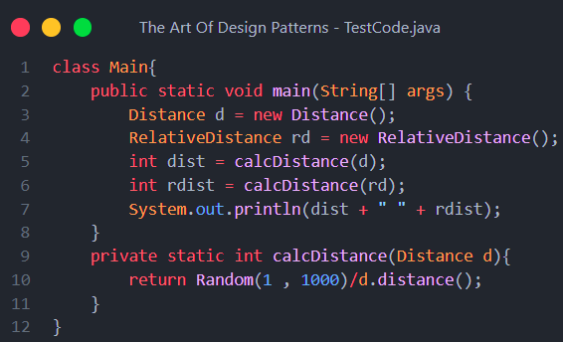
What’s the problem with this Code?

Slide 51
RelativeDistance object also IS – A Distance object by inheritance
Which means it can be passed in its place
Passing a RelativeDistance object could potentially cause the code to throw java.lang.ArithmeticException: / by zero “Due to division by 0”,
Which would have never happened if we passed a parent Distance object
Notes:
How can we solve this ?

Slide 52
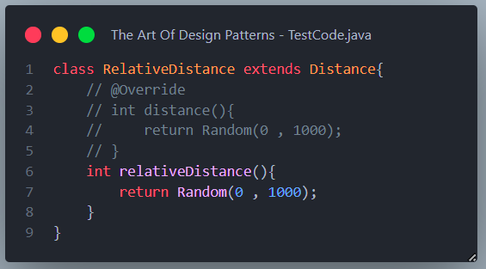
Solution: introduce new functions for new logic
Note: only do this when overriding will break your code, in most cases the output should be the same as the parent class or subset of it for the code to stay functional
Notes:
Can you think of other valid solutions ?

Slide 53
Other solutions:
Check for type using instanceof operator before executing logic
Use try-catch statements
Remove inheritance if it’s not necessary and duplicate parent class’s code “Not preferred”
Notes:
Can you think of other valid solutions ?

Slide 54
How to insure compatibility?
Parameter types in a method of a subclass should match or be more abstract than parameter types in the method of the superclass. (Same class or parent)
The return type in a method of a subclass should match or be a subtype of the return type in the method of the superclass. (Same class or child)
A method in a subclass shouldn’t throw types of exceptions which the base method isn’t expected to throw
Notice that: In most modern programming languages, especially statically typed ones (Java, C#, and others), these rules are built into the language. You won’t be able to compile a program that violates these rules.

Slide 55
A subclass shouldn’t strengthen pre-conditions.
Don’t add more restrictive constraints
A subclass shouldn’t weaken post-conditions.
Don’t change excepted logic from parent class
A subclass shouldn’t change values of private fields of the superclass.
Invariants of a superclass must be preserved.
Don’t change structure of attributes

Slide 56
Interface Segregation Principle
“Clients -Classes- should never be forced to depend on -Implement- methods they do not use”

Slide 57
How to use
Try to make your interfaces narrow enough that client classes don’t have to implement behaviors they don’t need.
break down “fat” interfaces into more granular and specific ones.
Clients should implement only those methods that they really need. Otherwise, a change to a “fat” interface would break even clients that don’t use the changed methods.
Class inheritance lets a class have just one superclass, but it doesn’t limit the number of interfaces that the class can implement at the same time
Notes:
Java allows classes to implement up to 65535 interfaces

Slide 58
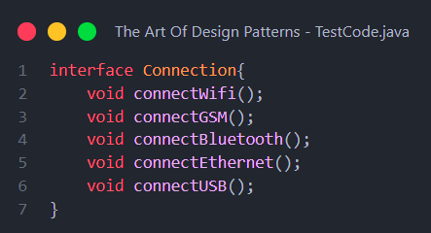
Code example
Imagine if all different clients had to implement this interface
Mobiles will never use the code of Ethernet or USB,
Web clients will never use the code for GSM “Mobile data”
But they are still forced to implement them

Slide 59
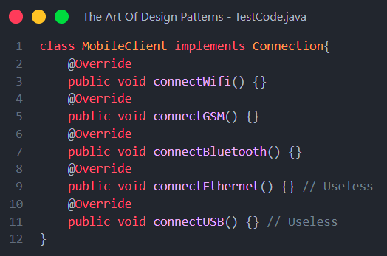
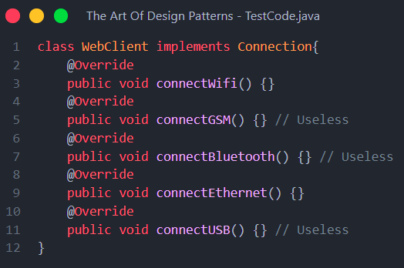
That’s what your code would look like

Slide 60
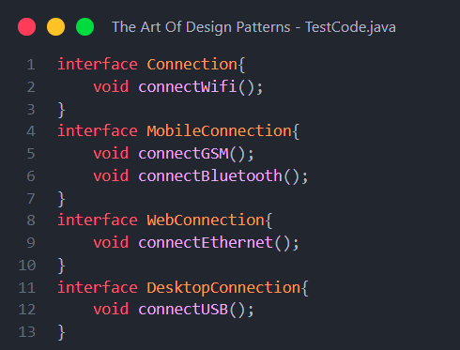
Solution
Divide “Fat” interface to multiple smaller ones specific to each client

Slide 61
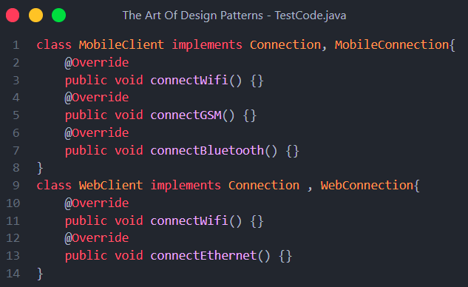
Solution
Now each client will only implement what it needs, which will result in smaller, more concise and less error-prone code

Slide 62
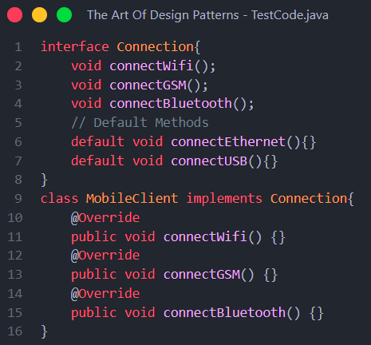
What if we use default implementation?
Now you don’t have to write the code but is it still a good idea ?
- Actually, NO !!, Never use default implementation unless they actually do something useful

Slide 63
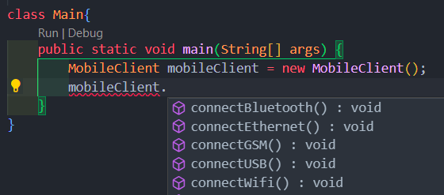




What if we use default implementation?
- The functions are still there and accessible by the object while they do nothing, even the autocomplete intellisense can suggest them for you, which is bad

Slide 64
Dependency Inversion Principle
Sometimes called IoC “Inversion of Control”
“High-level modules should Not Depend on anything from low-level modules.”
Both should depend on abstractions (e.g., interfaces).
Abstractions should not depend on details.
Details (concrete implementations) should depend on abstractions.

Slide 65

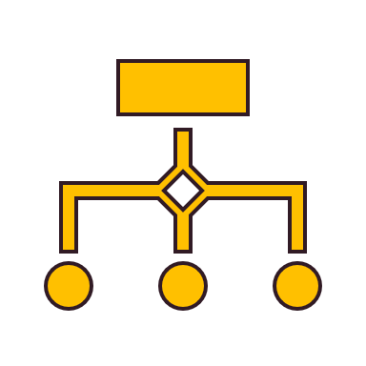
Low-level classes
High-level classes
Implement basic operations such as working with a disk, transferring data over a network, connecting to a database, etc.
Contain complex business logic that directs low-level classes to do something.

Slide 66


Example
Database is usually considered a low-level class

Slide 67
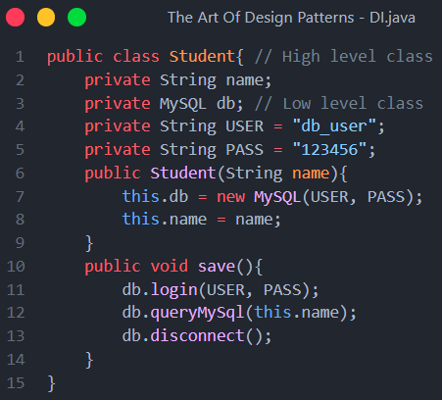
Student depends on MySql
Notes:
If we need to use another database or if MySQL fails major code Refactoring will be needed

Slide 68
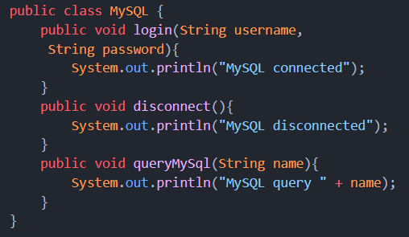
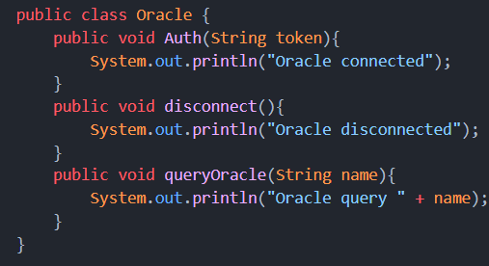
Problem?, Not all databases are created equal…
Notes:
If we need to use another database or if MySQL fails major code Refactoring will be needed

Slide 69
Program to an Interface not an Implementation
“Program to an interface, not an implementation. Depend on abstractions, not on concrete classes.”
Notes:
Design principle #2

Slide 70
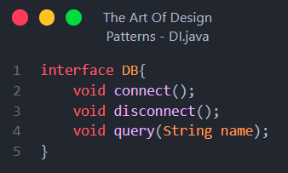
Solution
Design an interface for functionality you will be depending on, it doesn’t have to be one to one mapping of the functions of concrete class

Slide 71
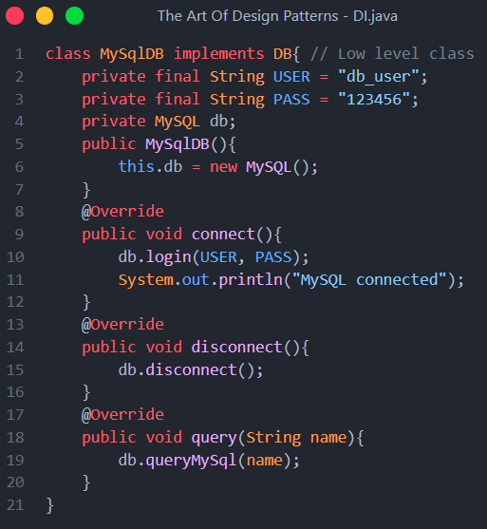
Solution
Implement the interface, for MySQL

Slide 72
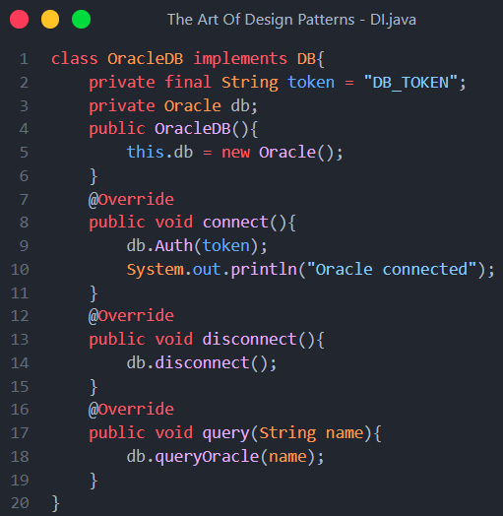
Solution
Implement the interface, for Oracle

Slide 73
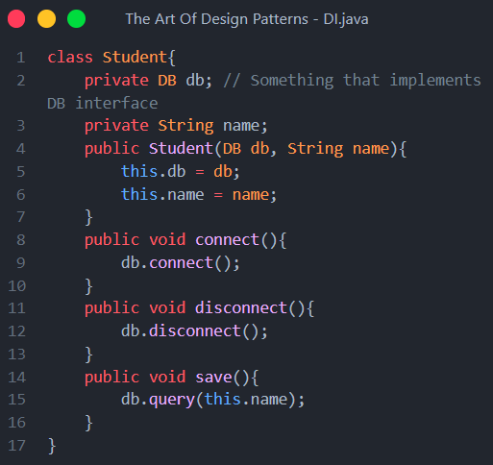
Solution
Depend on Abstraction

Slide 74
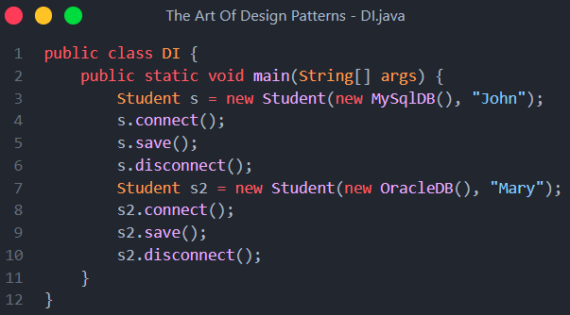
Result?
Student (High level class) is decoupled “Doesn’t depend on” MySql (Low Level class)

Slide 75
Favor Composition Over Inheritance
Notes:
Design principle #3

Slide 76
How to read UML Class diagrams
UML Class diagram is a standard notation used to describe and visualize relations between classes
Class diagram shows the classes, attributes, access modifiers, multiplicity, operations, and the relationship between them
Class diagram can be mapped directly with object-oriented languages. That is why they are frequently used in the modeling of object-oriented systems and are widely used during the construction of object-oriented systems.

Slide 77
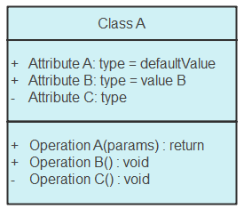
Class Notation
Class Name
Attributes
Access Modifiers
Operations (Functions)

Slide 78
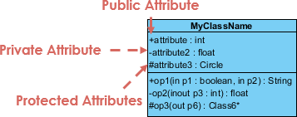
Class Visibility
The +, - and # symbols before an attribute and operation name in a class denote the visibility of the attribute and operation.
+ ➡️ Public
- ➡️ Private
# ➡️ Protected
~ ➡️ Default (Package local)

Slide 79
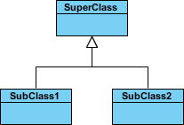
Relationships between classes
Inheritance (or Generalization):
Represents an "is-a" relationship.
An abstract class name (or interface) is shown in italics.
SubClass1 and SubClass2 are specializations of their Super Class.

Slide 80
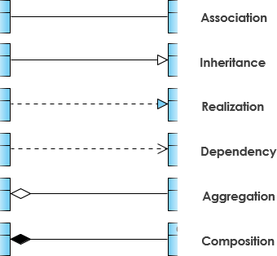
Other Relation Types
IS-A “They have common structure ”
Implements “Class & Interface”
Has-A “Can exist without it”
Has-A “Can’t exist without it”

Slide 81

Any Questions?

